Slide 1
Day 29
Bug Algorithms

Slide 2
Fundamental Problems
Chapter 2 of Dudek and Jenkin begins:
  "Before delving into the harsh realities of real robots...“
lists 5 fundamental problems
  path planning
  localization
  sensing or perception
  mapping
  simultaneous localization and planning

Slide 3
A Point Robot
represents a mobile robot as a point in the plane*
the point P fully describes the state of the robot
  called pose or configuration
robot motion causes the state to change

Slide 4
Free Space and Obstacles
the set of valid poses is called the free space C_{free} of the robot
the invalid poses are obstacles
obstacle
obstacle
obstacle
point
robot
freespace
obstacle
obstacle

Slide 5
Path Planning
is it possible for the robot to move to a goal configuration while remaining in C_{free} ?
obstacle
obstacle
obstacle
start
goal
freespace
obstacle
obstacle

Slide 6
Path Planning Using Bugs
bug algorithms assume:
  point robot
  known goal location
  finite number of bounded obstacles
  robot can perfectly sense its position at all times
  robot can compute the distance between two points
  robot can remember where it has been
  robot can perfectly sense its local environment
  robot can instantaneously change direction

Slide 7
Bug Zero
assumes a perfect contact sensor
repeat
  head towards goal
  if goal is reached then stop
  if an obstacle is reached then follow the boundary until heading towards the goal is again possible

Slide 8
Bug Zero
obstacle
obstacle
a right turning bug
obstacle
start
goal
freespace
obstacle
obstacle

Slide 9
Bug Zero
obstacle
obstacle
obstacle
goal
start
obstacle
obstacle

Slide 10

Bug Zero
not guaranteed to reach the goal
goal
obstacle
gets stuck here because
as soon as it moves down
there is a path to the goal
that does not go through
the obstacle
start

Slide 11
Bug One
assumes a perfect contact sensor
repeat:
  head toward goal T
  if goal is reached then stop
  if an obstacle is reached then
    remember the point of first contact H (the hit point)
    follow the boundary of the obstacle until returning to H and remember the point L (the leave point) closest to T from which the robot can depart directly towards T
      if no such point L exists then the goal is unreachable; stop
    move to L using the shortest boundary following path

Slide 12
Bug One
obstacle
obstacle
obstacle
goal
start
obstacle
obstacle

Slide 13
Bug One
obstacle
obstacle
obstacle
goal
start
obstacle
L
obstacle

Slide 14
Bug One
obstacle
obstacle
obstacle
goal
start
obstacle
L
obstacle

Slide 15
Bug One
obstacle
obstacle
obstacle
goal
start
obstacle
obstacle

Slide 16
Bug Two
Bug Two uses a line, called the m-line, from the start point to the goal
  sometimes called the direct path
obstacle
obstacle
obstacle
goal
m-line, or direct path
start
obstacle
obstacle

Slide 17
Bug Two
assumes a perfect contact sensor
repeat:
  head toward goal T along the m-line
  if goal is reached then stop
  if an obstacle is reached then
    remember the point of first contact H (the hit point)
    follow the boundary of the obstacle until the m-line is crossed at a leave point closer to the goal than H
      if no such point L exists then the goal is unreachable; stop
    leave the obstacle and head toward T

Slide 18
Bug Two
obstacle
obstacle
obstacle
goal
m-line, or direct path
start
obstacle
obstacle

Slide 19
Bug Two

Slide 20
Bug One versus Bug Two
Bug One uses exhaustive search
  it considers all leave points before leaving the obstacle
Bug Two uses greedy search
  it takes the first leave point that is closer to the goal

Slide 21
Sensing the Environment
Bug1 and Bug2 use a perfect contact sensor
we might be able to achieve better performance if we equip the robot with a more powerful sensor
a range sensor measures the distance to an obstacle; e.g., laser range finder
  emits a laser beam into the environment and senses reflections from obstacles
  essentially unidirectional, but the beam can be rotated to obtain 360 degree coverage
  http://velodynelidar.com/lidar/lidar.aspx

Slide 22
Tangent Bug
assumes a perfect 360 degree range finder with a finite range
  measures the distance ρ(x, θ) to the first obstacle intersected by the ray from x with angle θ
  has a maximum range beyond which all distance measurements are considered to be ρ = ∞
the robot looks for discontinuities in ρ(x, θ)

Slide 23
Tangent Bug
O₂
O₃
O₁
O₆
O₄
O₅

Slide 24
Tangent Bug
currently, bug thinks goal is reachable so it moves toward the goal
  called “motion to goal” mode
goal

Slide 25
Tangent Bug
once the obstacle is sensed, the bug needs to decide how to navigate around the obstacle
move towards the sensed point O_{i} that minimizes the distance d(x, O_{i}) + d(O_{i}, q_{goal}) (called the heuristic distance)
O₁
goal

Slide 26
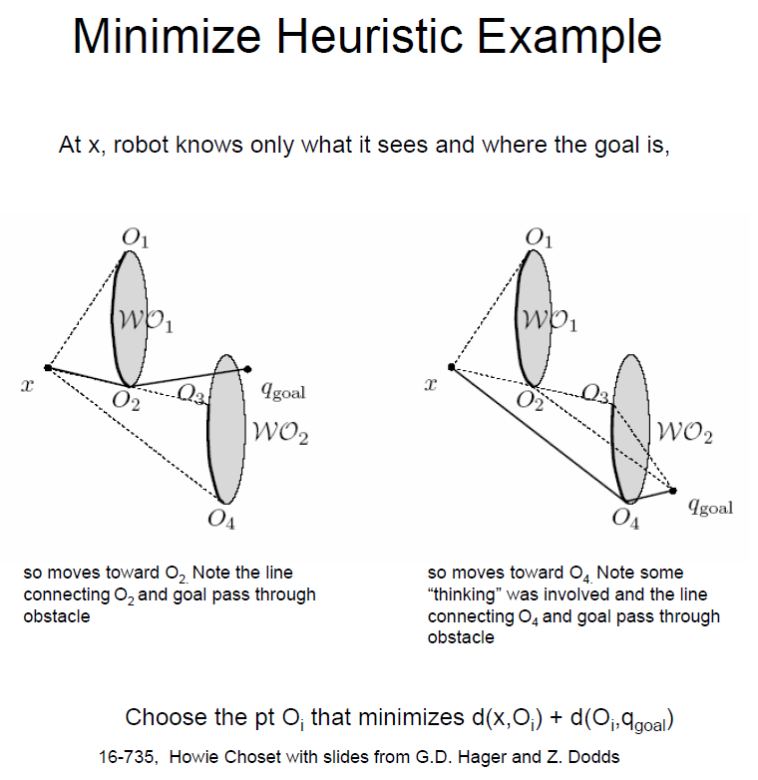
Tangent Bug

Slide 27
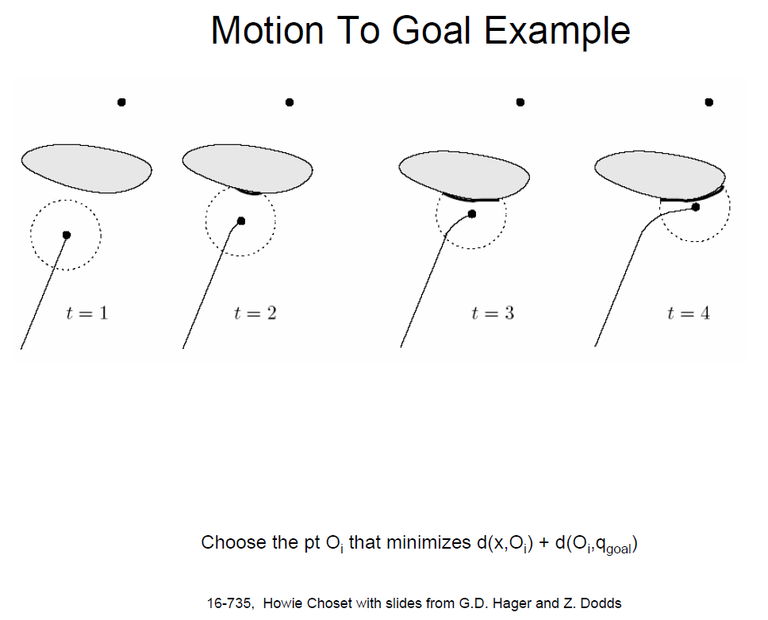
Tangent Bug

Slide 28
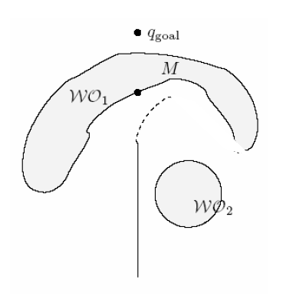
Tangent Bug
problem with concave obstacles
  eventually the robot reaches a point where d(x, O_{i}) + d(O_{i}, q_{goal}) starts to increase
  once this happens, the robot switches to “boundary following” mode

Slide 29
Tangent Bug
trick here is that the robot remembers the distance d_{following} between M and q_{goal}
  M is the point on the blocking obstacle that had the shortest distance to the goal when the heuristic distance started to increase

Slide 30
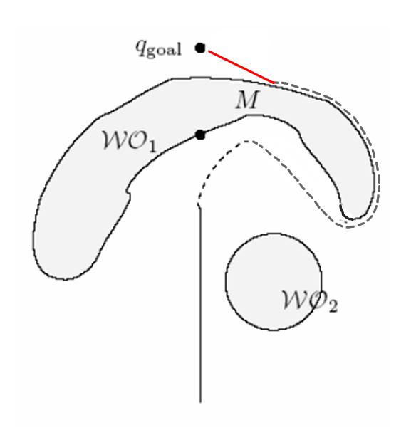
Tangent Bug
the robot returns to “motion to goal” mode as soon as it reaches a point where the distance between a sensed point and the goal or the distance between the robot location and the goal is less than d_{following}

Slide 31
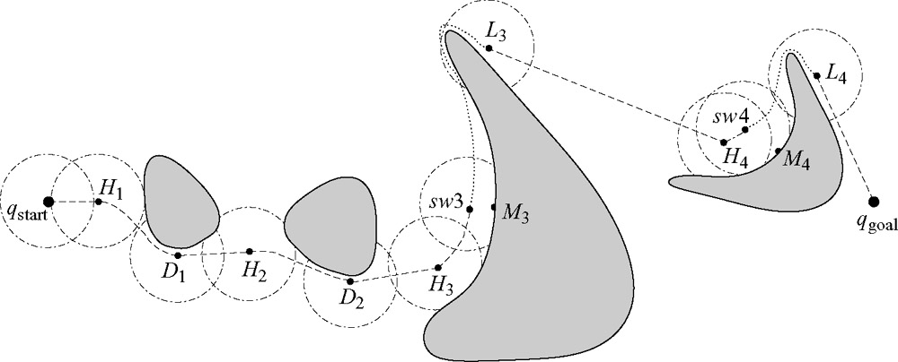
Tangent Bug

Slide 32
Tangent Bug
full details
  Principles of Robot Motion: Theory, Algorithms, and Implementations
  http://www.library.yorku.ca/find/Record/2154237
nice animation
  http://www.cs.cmu.edu/~motionplanning/student_gallery/2006/st/hw2pub.htm

